Slide 1
Phase 3 sounds

Slide 2
j

Slide 3
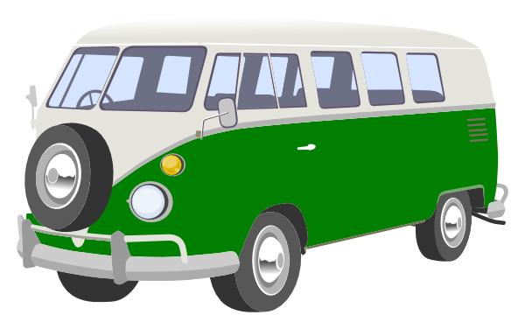
v

Slide 4
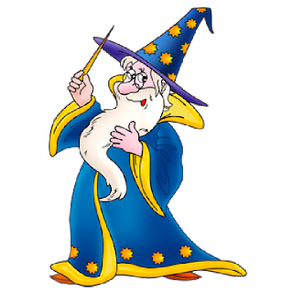
w

Slide 5
x

Slide 6
y

Slide 7
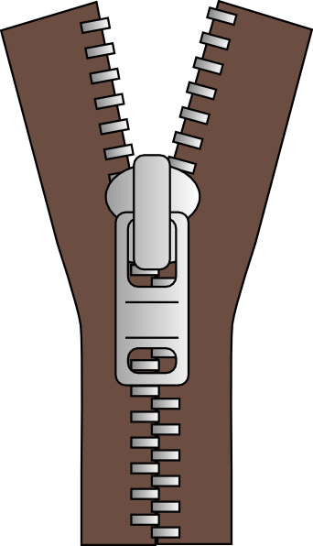
z

Slide 8
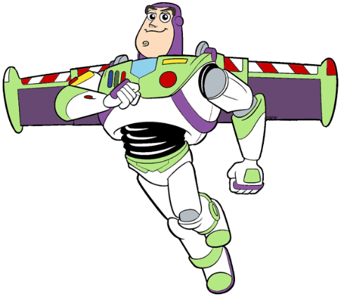
zz

Slide 9
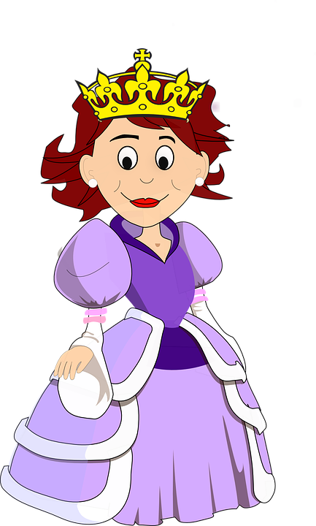
qu

Slide 10
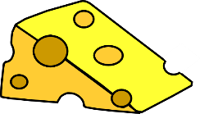
ch

Slide 11
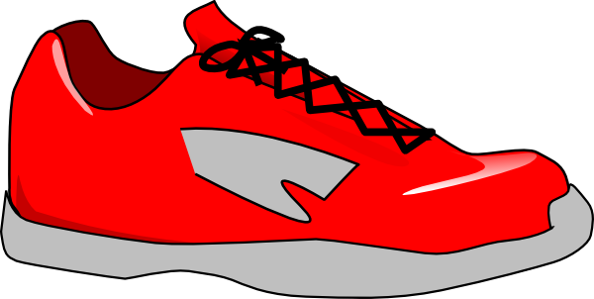
sh

Slide 12
th

Slide 13
ng

Slide 14
ai

Slide 15
ee

Slide 16
igh

Slide 17
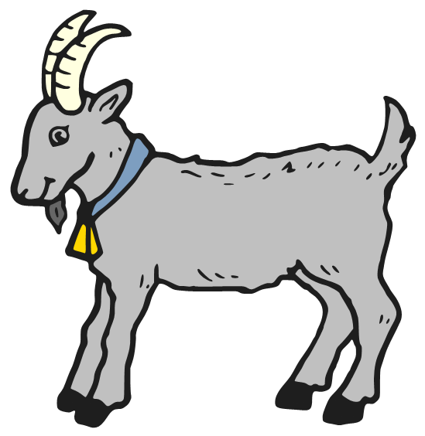
oa

Slide 18
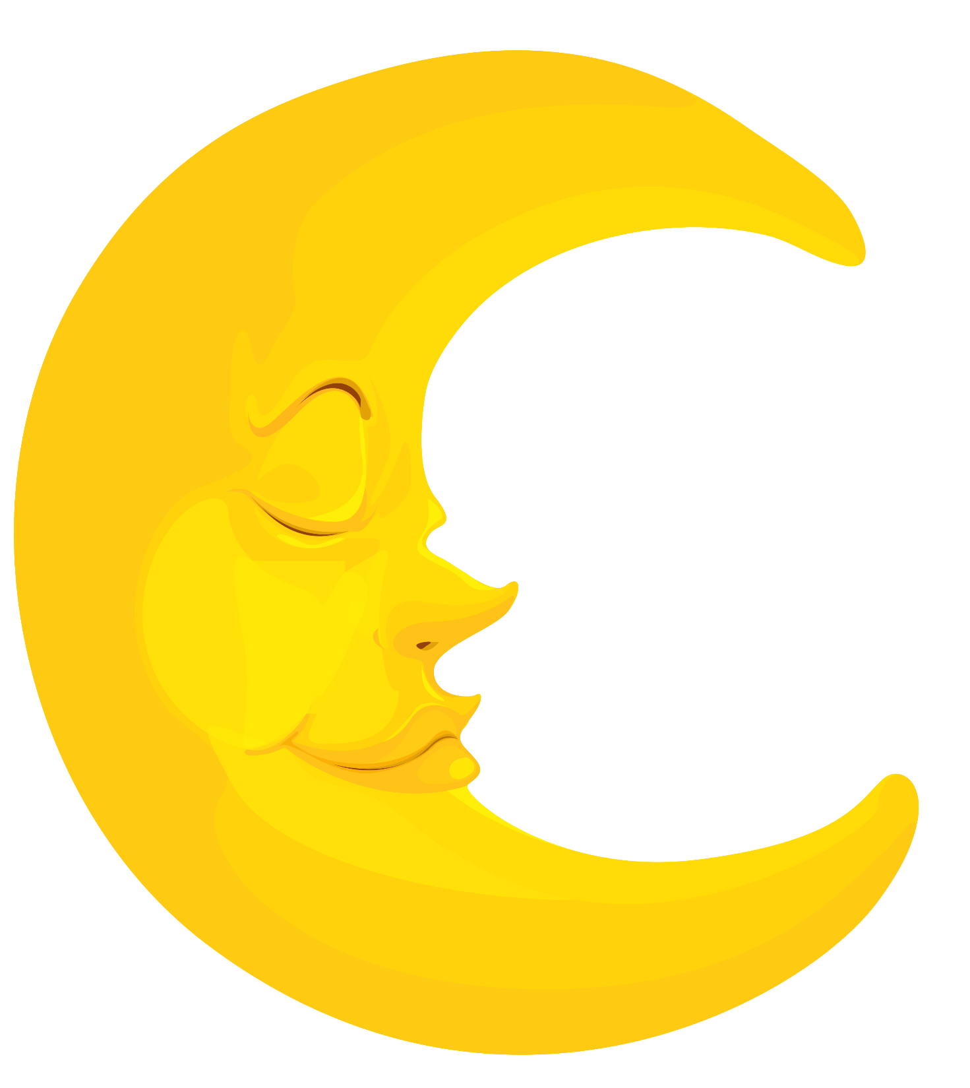
oo

Slide 19
oo

Slide 20
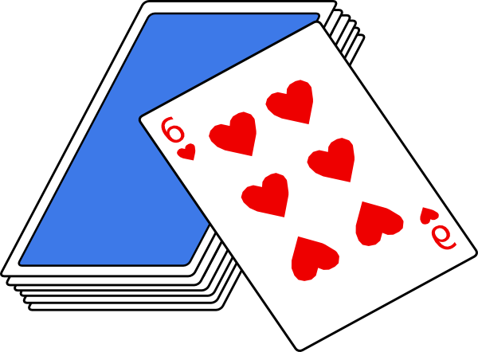
ar

Slide 21
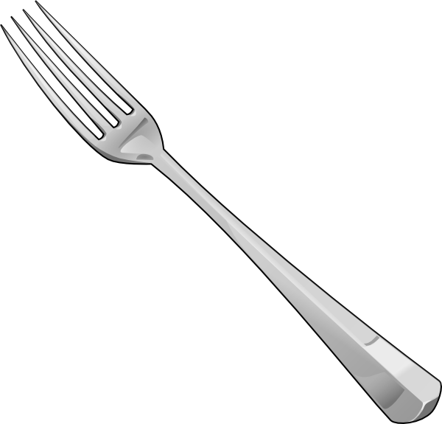
or

Slide 22
ur

Slide 23
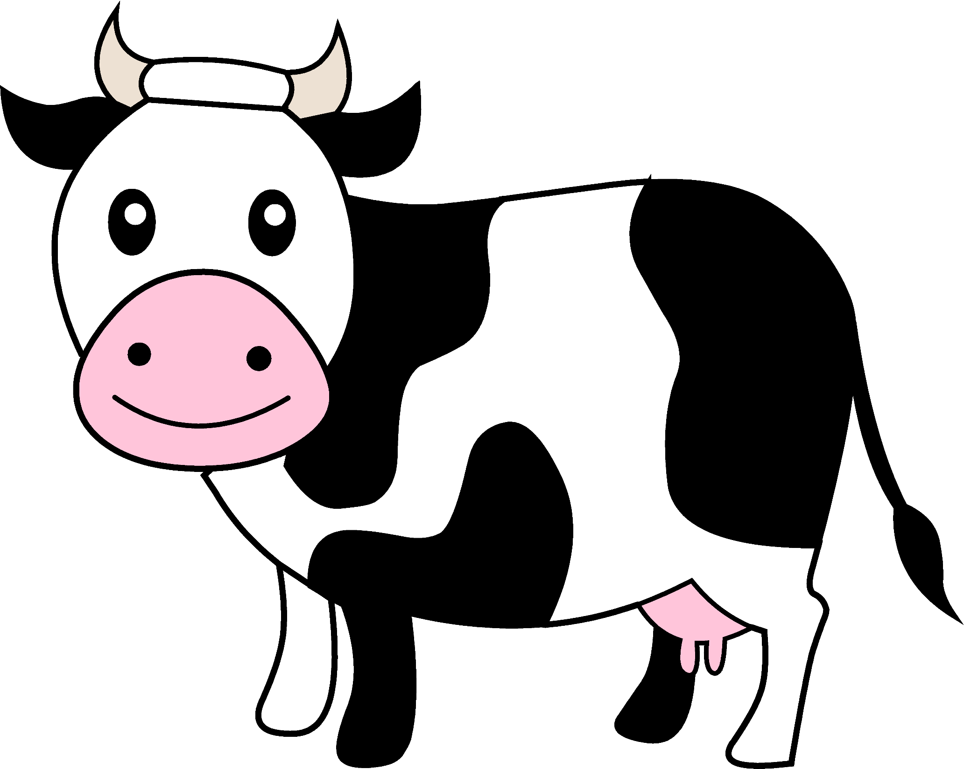
ow

Slide 24
oi

Slide 25
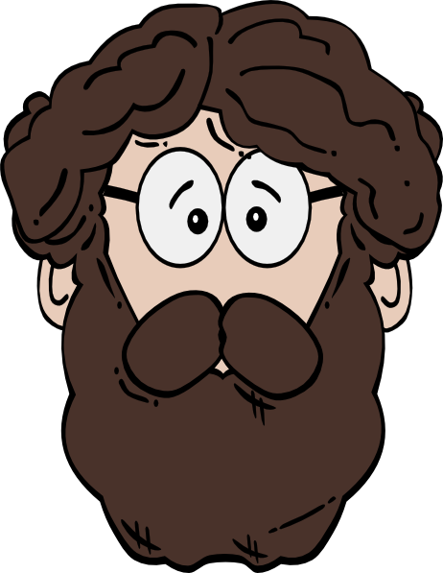
ear

Slide 26
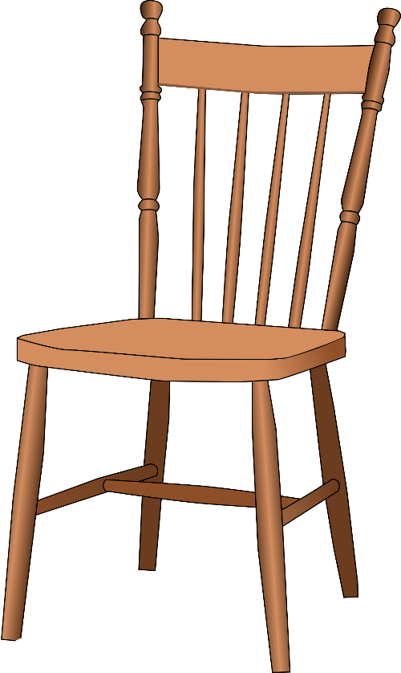
air

Slide 27
ure

Slide 28
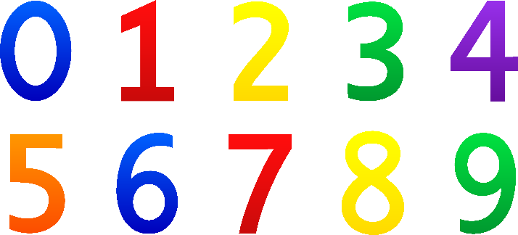
er

Slide 29
Tricky words

Slide 30
he

Slide 31
she

Slide 32
we

Slide 33
me

Slide 34
be

Slide 35
you

Slide 36
are

Slide 37
all

Slide 38
they

Slide 39
her

Slide 40
my

Slide 41
was

